Slide 1
Condensation of Adjacency matrix with parallel edges
Presented By:-
Maharshi Roy (ISM2014006)
Rajat Kumar Sahu (IHM2014501)
Amrit Daimary (IRM2014001)

Slide 2
Condensation of adjacency matrix
Since the graph is undirected, we can perform the most trivial optimization of storing only upper or lower triangle of the whole matrix, cutting space occupied by half.
We then propose 3 different algorithms to condense the graph without losing information:-
Numerical Base Method
Static Length Bit-string conversion
Variable Length Bit-string conversion

Slide 3
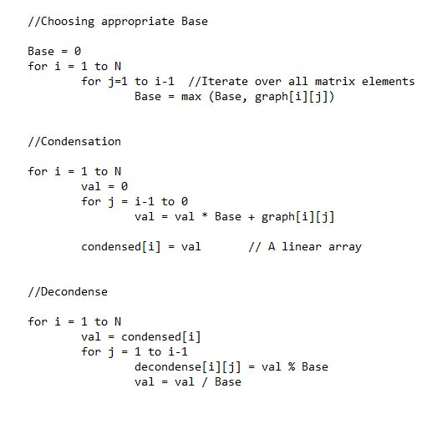
Numerical base Method
In this method, we convert the matrix rows representing each vertex into a single integer by choosing an appropriate base.
The base is chosen as:-
b=max(u1,u2,u3,,,un)+1
I.e. 1 value greater than the maximum edge value.
3) Then each row is converted to a
Single numerical value as:-
val=u1+u2*b+u3*b^2+...un*b^(n-1)
4) This way we reduce our space
from O(n^2) to O(n).
5) However, this method suffers
From the obvious problem of
Overflow.

Slide 4
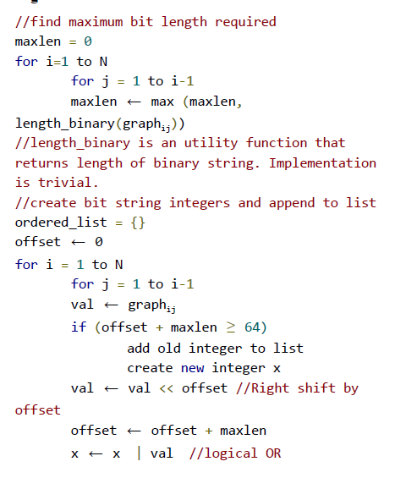
BIT-STRING METHOD (STATIC LENGTH)
In this method, we using 64 bit integers to store information.We try to utilize all 64 bit by not storing leading zeros for small numbers.
We find maximum bit length required to represent a number according given input.The maxlen is chosen as:-
maxlen=max(u11,u12,u3,..,unn)
uij=binary_length(graph[i][j])
Divide 64 bit in chunks of maxlen bit and store edge informations sequentially.
When unable to store upcoming edge information append next 64 bit in same fashion until all information store.
For an immensely dense graph, where all matrix values are of order ~ 2(50−60) , almost a single integer is required for all the edges. In such a worst case, space required is more or less same.

Slide 5
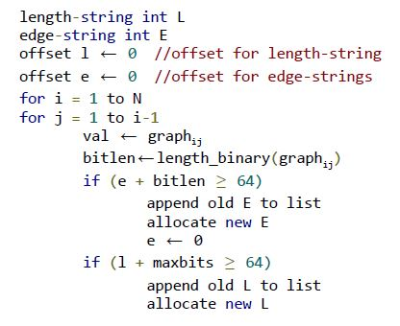
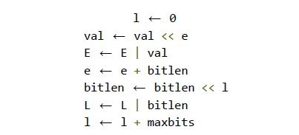
BIT-STRING METHOD (VARIABLE LENGTH)
In static length bit-string conversion, we can reduce bit-space wastage further by noticing that many small edge values will have leading zeros in case max bit length is large.
In this method we keep 2 separate set of integers :-
length-string: stores the number of bits
required by graph[i][j]
value-string: stores value of graph[i][j]
We find
maxbits = maximum number of bit required
to store length of value of
graph[i][j].
Divide 64 bit integer of length-string in chunks of maxbits and store length of value of edge informations sequentially.
Corresponding that length is allocated in value-string to store value of edge sequentially.

Slide 6
COMPLEXITY ANALYSIS
Time Complexity
Space Complexity
Where k is the number of integers required
Method | Best Case | Average Case | Worst Case
Numerical Base | O(V²) | O(V²) | O(V²)
Bit-string(static) | O(V²) | O(V²) | O(V²)
Bit-string(variable) | O(V²) | O(V²) | O(V²)
Method | Best Case | Average Case | Worst Case
Numerical Base | O(V) | O(V) | O(V)
Bit-string(static) | O(1) | O(k) | O(V²)
Bit-string(variable) | O(1) | O(k) | O(V²)

